Slide 1
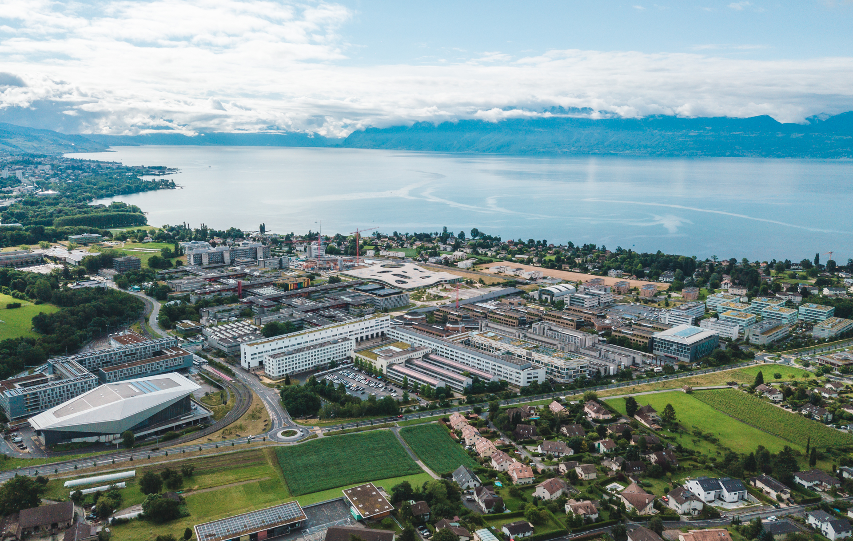
CIVIL-459 Project 20 Presentation
Group 14
David Rüegg
Stephen Monnet
May 2023

Slide 2
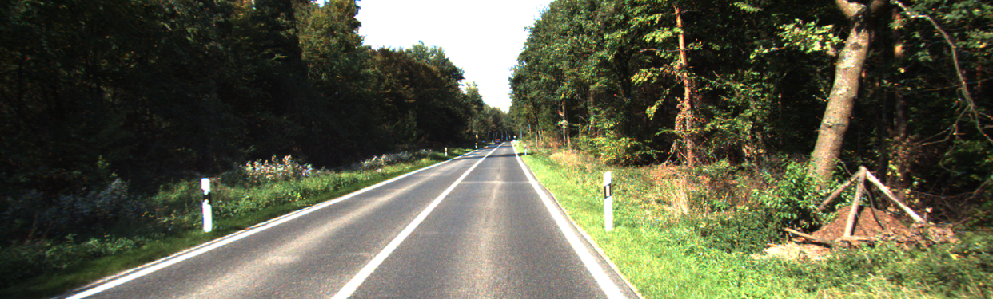
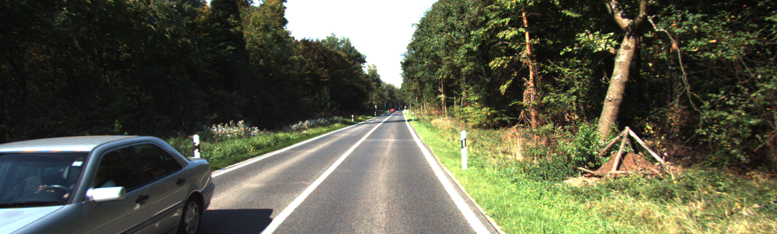
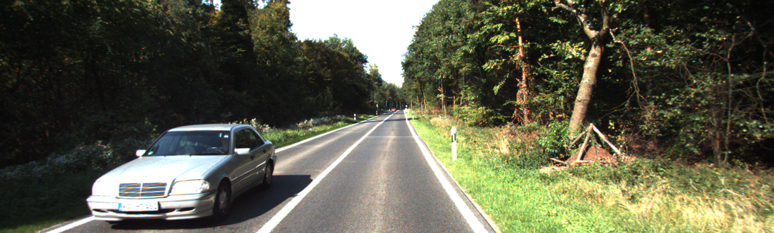
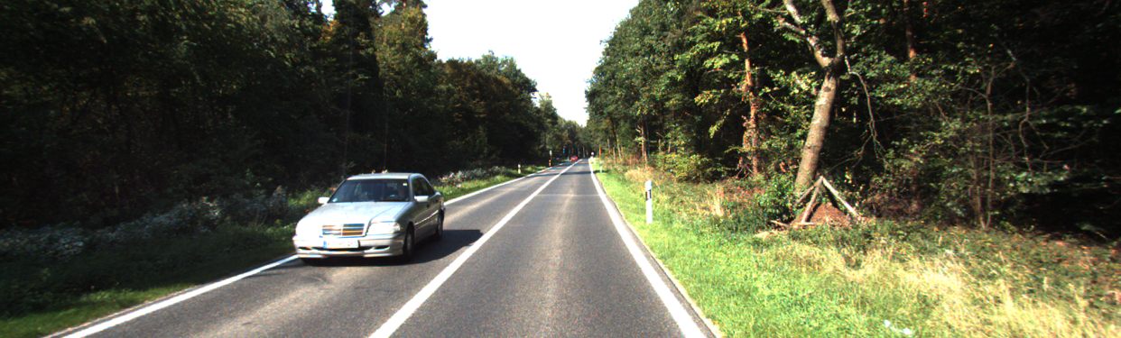


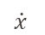
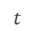
Vision-Based Vehicle Speed Estimation
Metric
L1
RMSE
Our Model
Kitti Dataset
Residential
City
Road
$$\dot{x}$$
$$t$$

Slide 3









Method (1/2)
Detection
You Only Look Once V8 (YOLO)
Optical Flow
Recurrent All-Pairs Field Transforms (RAFT)
Depth
Dense Prediction Transformers (DPT)

Slide 4
Method (2/2)
Optical Flow
CNN
Max Pooling
Leaky ReLU
Fully connected
Detection
Depth
Conv2d
stack
maxPool
Leaky ReLu

Slide 5
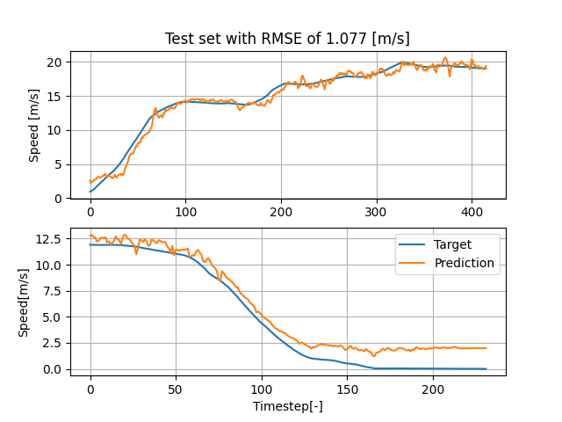
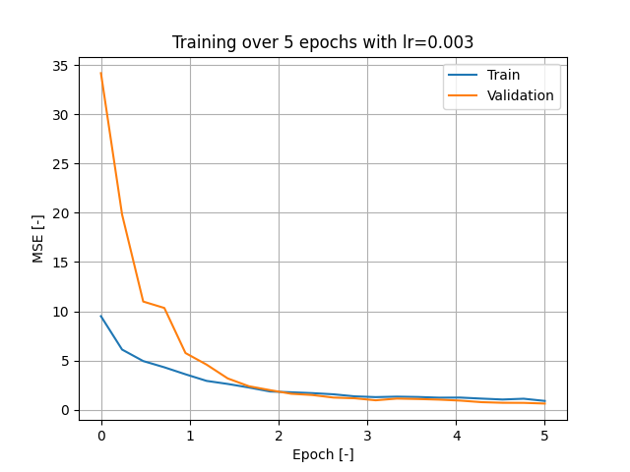
Results : No Detection Mask
Noisy prediction
Bad estimation at low speed
State of the art : RMSE = 0.977 [m/s]

Slide 6
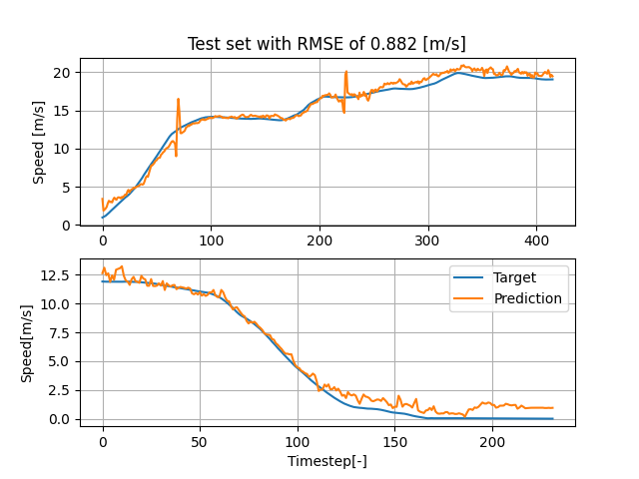
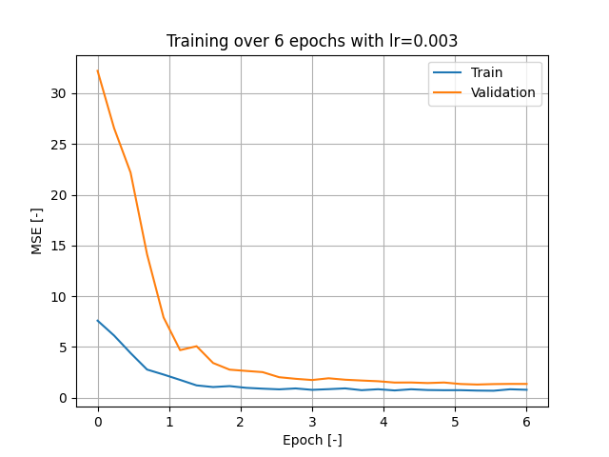
Results : With Detection Mask
Still Noisy
Mask improves low-speed estimation
Better RMSE than state of the art ! → Promising

Slide 7
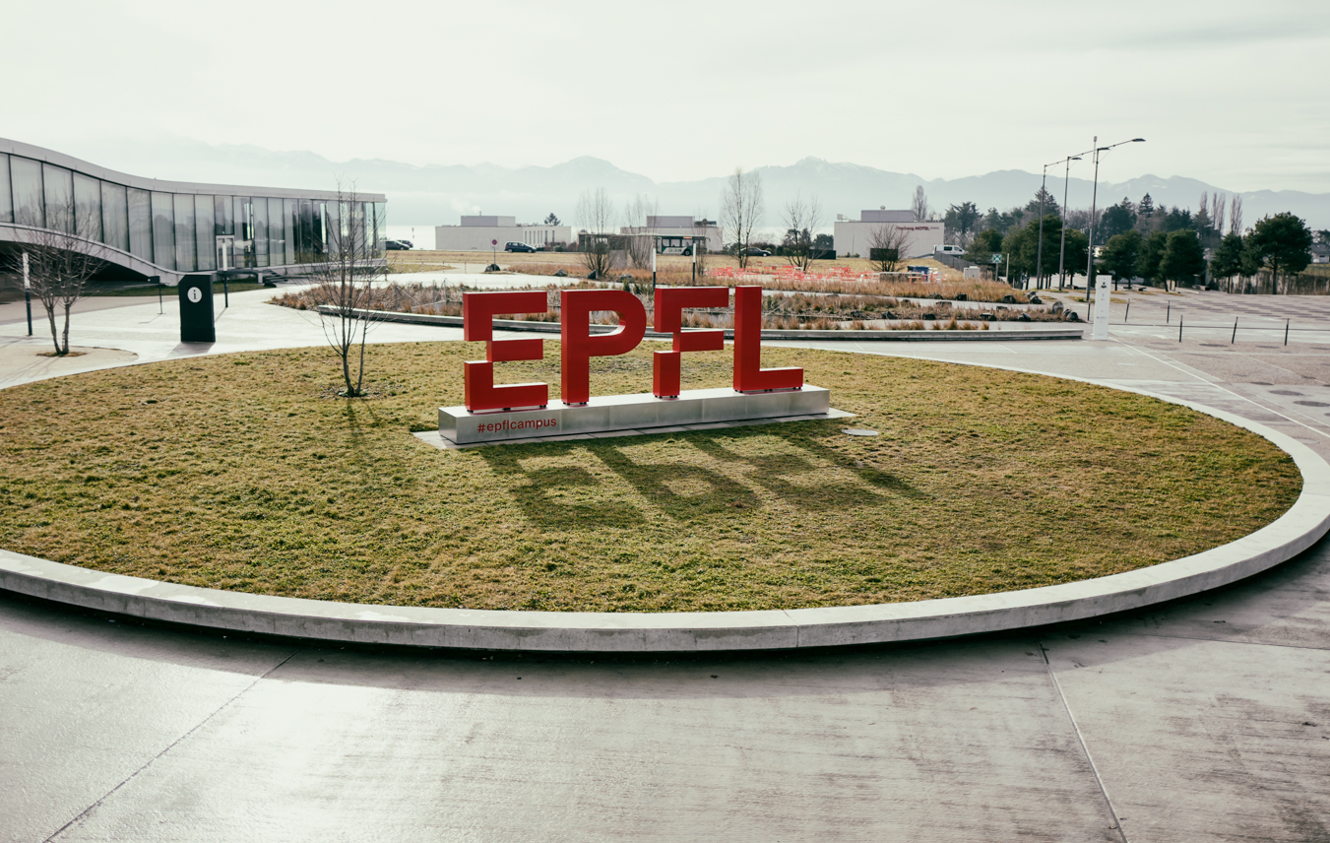
Merci
Group 14
David Rüegg
Stephen Monnet

